Slide 1
16: 332: 568
SOFTWARE ENGINEERING OF WEB APPLICATIONS
“TIMING THE MARKET”
Project Presentation
Project group : 5
Amarinder Cheema
Ateet Vora
Chetan Jain
Puneet Kataria
Ronak Shah
Siddharth Wagh
Presentation date: 7 March, 2008

Slide 2
OUR CLOSEST COMPETITORS
Softwares | Attributes
 | Charting | Scanner | Built-in indicators | Data feed | Online/ Download | Alerts
Optimal Trader | Yes | Yes | 15 | EOD, Delayed | D | No
Ninja Trader | Yes | Yes | 100 | EOD, RT, Delayed | D | Yes
Stocker | No | Yes | 13 | Delayed | D | No
TA- Lib | No | No | 125 | No | D | No
Meta Stock | Yes | Yes | 200 | EOD, RT, Delayed | D | Yes
“Timing the Market” | Yes | Yes | 20 | EOD, Delayed | OL | Yes

Slide 3
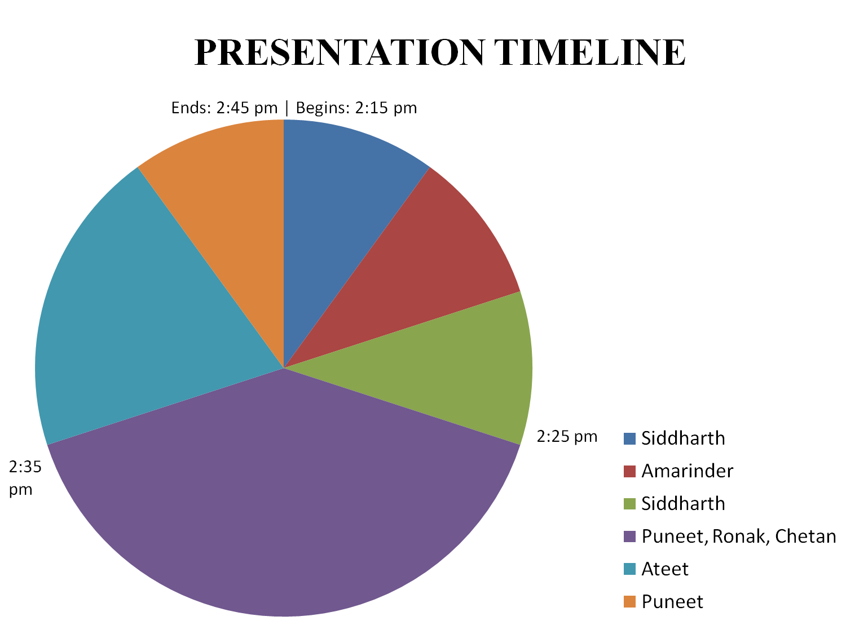
2:42pm
Project
Background
2:18 pm
Summary
Use cases
2:22 pm
Sources of data
Web service interface
Presenters:
Indicators and algorithms

Slide 4
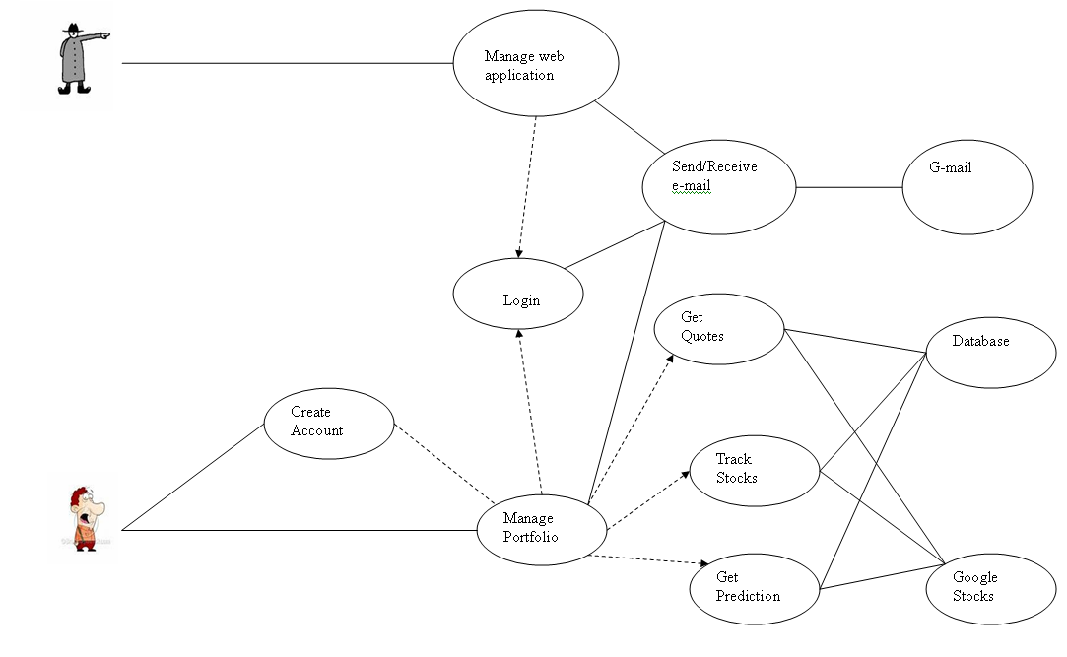
USE CASE DIAGRAM

Slide 5
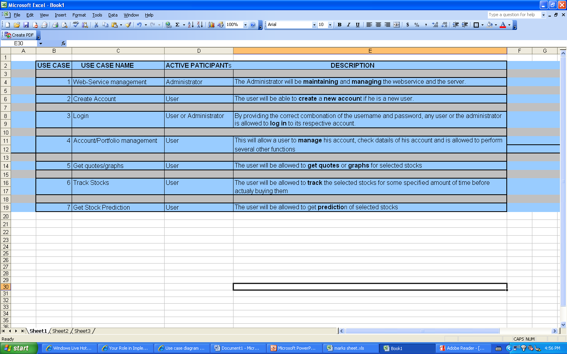
USE CASE DESCRIPTION TABLE

Slide 6
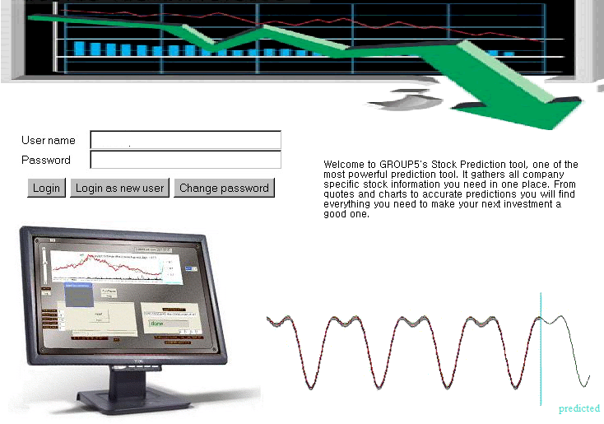

Slide 7
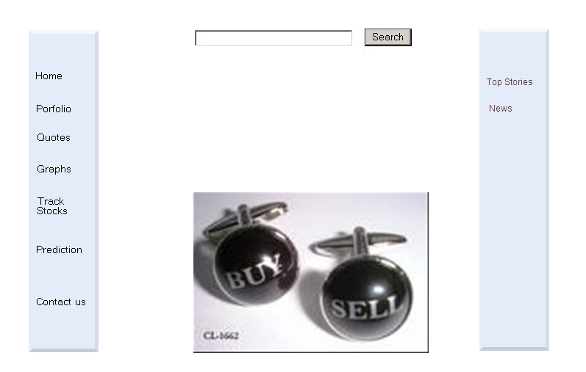

Slide 8
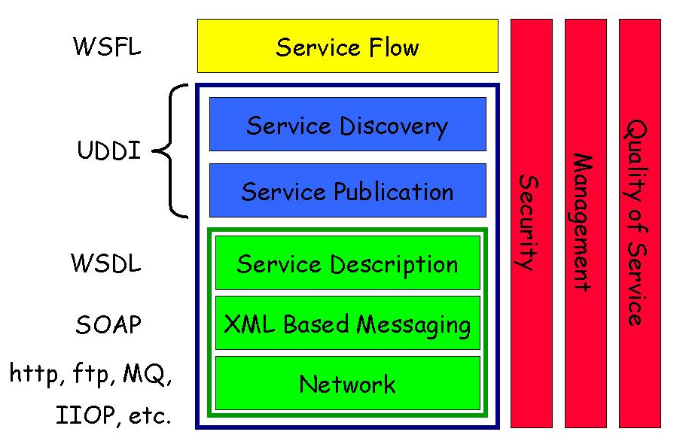
WEB SERVICES STACK

Slide 9
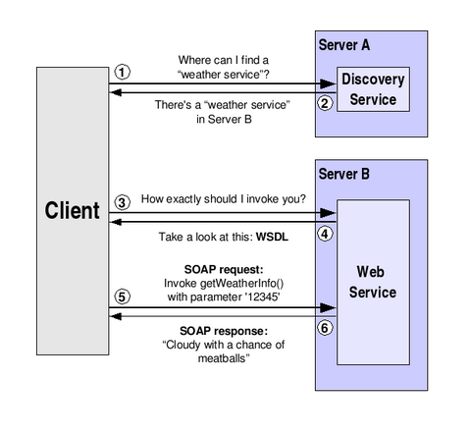
USING A WEB SERVICE

Slide 10
CALLING SERVICE METHODS
1. Attaching WebService behavior:
  Use BODY tag and include ‘behavior’ in STYLE attribute
  Download the WebService HTC file and copy it to the same directory as the Web page that uses the behavior
2. Loading web service URL:
Useservice method() for URL reference
3. Sending A Message to the Web Service
Call the callService() method
4. Handling the result Object
Use event handler
5. Defining the Calling Buttons
<BODY ID="webServiceCallerBody" STYLE="behavior:url(webservice.htc)"></BODY>
sElementID.useService(sWebServiceURL, sFriendlyName [, oUseOptions]);
iCallID = id.FriendlyName.callService([CallbackHandler,] "MethodName", Param1, Param2, ...);

Slide 11
USING METHODS IN
‘WEB SERVICE BEHAVIOR’
createUseOptions()
Syntax: objReuseConn = sElementID.createUseOptions ([boolReuseConn])
Role: Authentication persistency
createCallOptions()
Syntax: objCallOptions.createCallOptions(functionName, portName, asyncMode, timeOut, userName, passWord, soapHeader, endPoint, params);
Role: creates an object of options
callService()
Syntax:
iCallID = sElementID.sFriendlyName.callService( [oCallHandler], funcOrObj, oParam);
Role: initiates the engagement of the WebService behavior with the Web service
useService()
Syntax: sElementID.useService(sWebServiceURL, sFriendlyName [, oUseOptions]);
Role: establishes a friendly name for a Web service

Slide 12
DOW THEORY
Six tenets :
Markets have 3 trends
Trends have three phases
Market Discounts all news
Market averages must confirm each other
Trends are confirmed by volume
Trends exist until definitive signals prove that they have ended

Slide 13
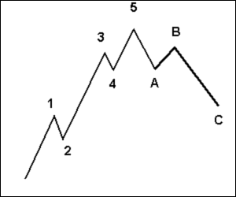
ELLIOT WAVE THEORY
It is based on mass psychology and represents a 5-3 wave structure
Numbered Phase : Waves 1, 3, 5 are called impulse waves
Waves 2 and 4 are called corrective waves
Lettered Phase : After 5 wave numbered advance , a three way correction begins. They are identified as a, b and c
Practitioners study developing price moves
to distinguish the waves and wave
structures, and discern what prices may do
next; thus the application of the wave
principle is a form of pattern recognition.

Slide 14
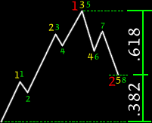
PHI AND FIBONACCI SERIES
Fibonacci sequence surface repeatedly in Elliott
wave structures, including motive waves
(1, 3, 5), a single full cycle (5 up, 3 down
= 8 waves), and the completed motive
(89 waves) and corrective (55 waves) patterns
The end price is 61.8% of the high and 0.618 is equal to 1/Φ and 0.382 is 1/ Φ^ 2

Slide 15
PATTERN
RECOGNITION

Slide 16
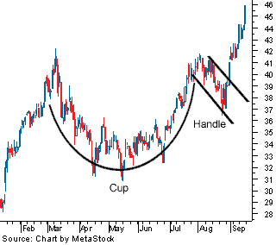
CUP AND HANDLE
Cup and handle patterns are found within up-trends.
Named for their appearance which resembles a cup and handle.
This pattern is the result of a resting period in the stock, with the round cup shape followed by narrow price action which forms the appearance of the handle.
The technical buy point is as the stock clears the handle area to the upside, ideally on volume expansion.

Slide 17
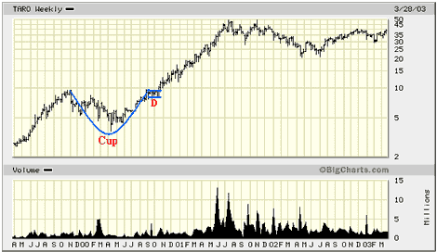
The graph below shows a company developed a Cup for 10 Months and then formed a 6 Week Handle (point D) before breaking out in October. The company then rose from $17 to $50 a share for a gain of 190% over the next 6 Months.
By focusing on companies with good fundamentals that are breaking out of a favorable chart pattern such as a "Cup and Handle" will allow you to find winning stocks even in a Bear Market environment.

Slide 18
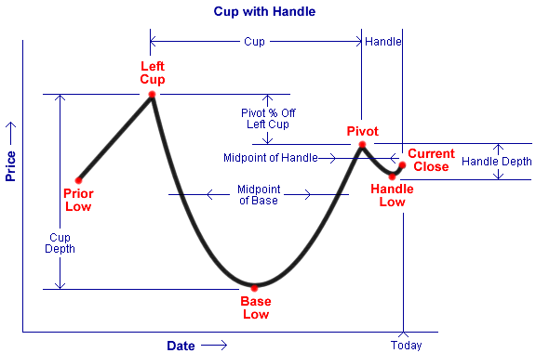
POINTS | DEFINITION
Current Close | The price at which the stock closed on the day. This is updated each day that the stock remains on the list
Average Volume | The average daily volume.
Cup | Trading days between Left Cup and Current Close.
Handle | Action on the right side of the Cup in which the price has discontinued rising, falling back slightly in a tight consolidation. (see Pivot)
Cup: Handle Ratio | The length of the cup relative to the length of The handle.
Handle Low | Lowest intraday low within the Handle.
Pivot | Highest intraday high that marks the beginning of the Handle.
Handle Depth | Difference between the Pivot and the Handle Low, expressed as a percentage of the Pivot.
Pivot % off Left Cup | Difference between the Left Cup and the Pivot, expressed as a percentage of the Left Cup.

Slide 19
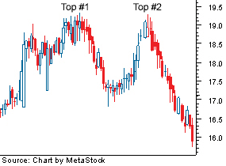
DOUBLE TOP
The double top is a reversal pattern
of an upward trend in a stock's price.
It marks an uptrend in the process of
becoming a downtrend.
Double top consists of two well-
defined, sharp peaks at approximately
the same price level.
Prices rise to a resistance level, retreat
return to the resistance level again
before declining.
Volume contracts on second peak as a
further indication of weakening demand.
Support must be broken in a convincing manner, and usually with an expansion of volume

Slide 20
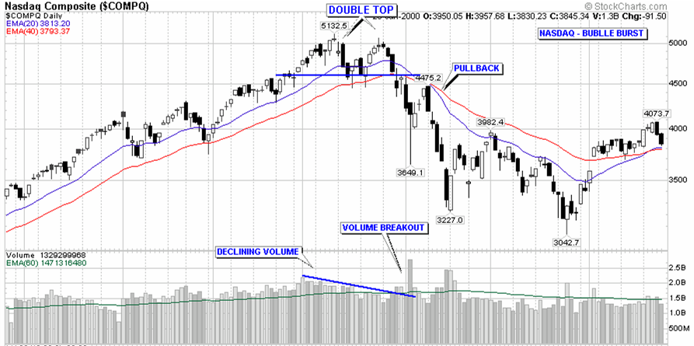
Trading this pattern:
Calculate the height of the pattern by subtracting the lowest low from the highest high in the formation. Then, subtract the height of the pattern from the lowest low.
In other words, an investor can expect the price to move downwards at least the distance from the breakout point less the height of the pattern.

Slide 21
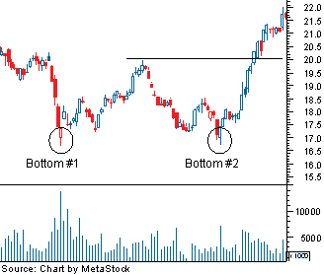
DOUBLE BOTTOM
The double bottom is a reversal pattern
of an downward trend in a stock's
price.
Double bottom consists of two well-
defined, sharp lows at approximately
the same price level.
Prices fall to a support level, rally and
pull back up, then fall to the support
level again before increasing.
The pattern is complete when prices
rise above the highest high in the
formation

Slide 22
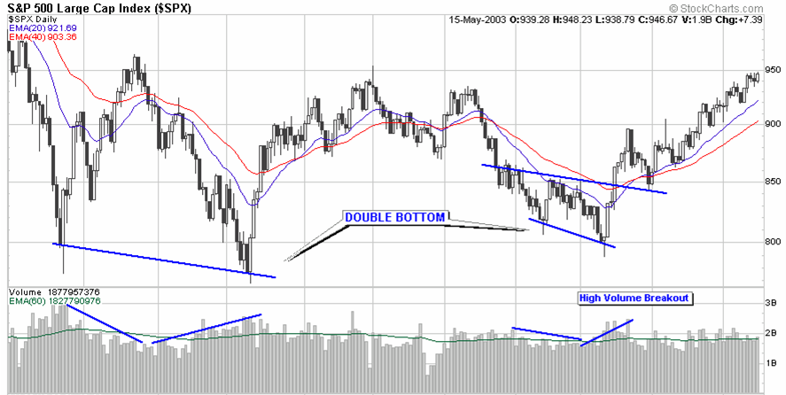
Trading this pattern:
Calculate the height of the pattern by subtracting the lowest low from the highest high in the formation. Then, add the height of the pattern to the highest high.
In other words, we can expect the price to move upwards at least the distance from the breakout point plus the height of the pattern.

Slide 23
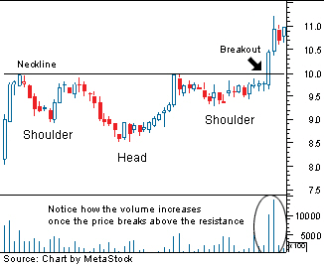
HEAD AND SHOULDER (REVERSE)

Slide 24
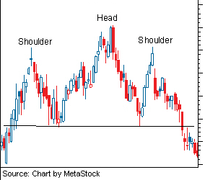
HEAD AND SHOULDER (TOP)

Slide 25
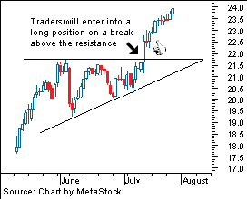
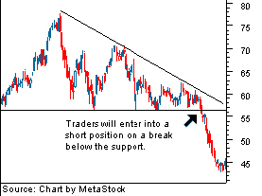
TRIANGLES
Ascending Descending

Slide 26
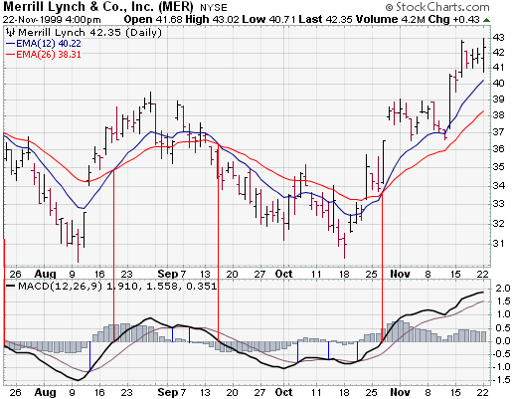
INDICATOR
Moving Average Convergence
(Short term moving average - Long term moving Average)

Slide 27
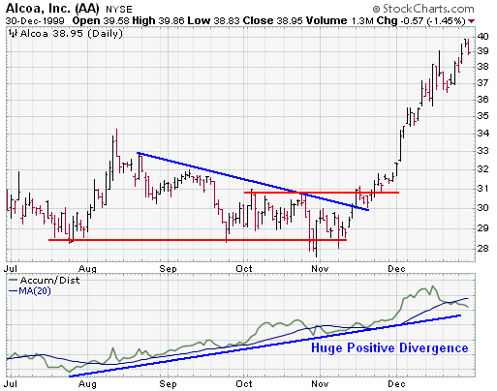
INDICATORS (CONTD.)
Accumulation/Distribution Line
(((Close-low)-(High-Low))/(High-Low))*Volume

Slide 28
Raw Data Type
End Of Day(EOD) and Delayed Data feeds
EOD data provides closing price for the given equity.
Delayed data is basically 15-30 minutes delayed

Slide 29
Analysis Data
Currently using Google Finance for
  Opening prices
  Closing prices
  Lowest prices
  Highest prices
  Volume of shares
  Market Cap.

Slide 30
Methods for Processed Data Implementation
RSS Feeds to display latest news, market trends, blogs etc.
Google Analytics for dashboard type feature for Site Administrators

Slide 31
Member
Task | AMARINDER | ATEET | CHETAN | PUNEET | RONAK | SIDDHARTH
Project Feasibility
Study Of Fundamental and Technical Analysis
Scripting languages
Backend Database handling
Web Services Interface design
Interim Presentation
Pattern Recognition
Machine Learning
Website design
Testing and Debugging
Documentation and Final Report
Final Presentation

Slide 32
Activities | Jan 21-30 |  |  |  | Feb1 -15 |  |  |  | Feb 15-29 |  |  |  | Mar 1-15 |  |  |  | Mar 15-31 |  |  |  | Apr 1-15 |  |  |  | Apr 15-30 |  |  |  | May 1-15
Project Feasibility
Study Of Fundamental and Technical Analysis
Scripting languages
Backend Database handling
Web Services Interface design
Interim Presentation
Pattern Recognition
Machine Learning
Website design
Risk Analysis
Testing
Debugging
Performance analysis
Documentation and Final Report
Final Presentation

